Slide 3
100%
94.4%
97.2%
94.4%
80.6%
83.3%
97.2%
63.9%

Slide 4
Th
Tc
Rh
Rc
ThRc
TcRh
ThRh
TcRc
Bh
Bc
Lh
Lc
BcLh
BhLc
BhLh
BcLc

Slide 5
Th
Tc
Bh
Bc
BcTh
BhTc
BhTh
BcTc
Rh
Rc
Lh
Lc
LhRc
LcRh
LhRh
LcRc

Slide 6
90%
91.7%
83.3%
90%
80%
86.7%
83.3%
86.7%
90%
80%

Slide 7
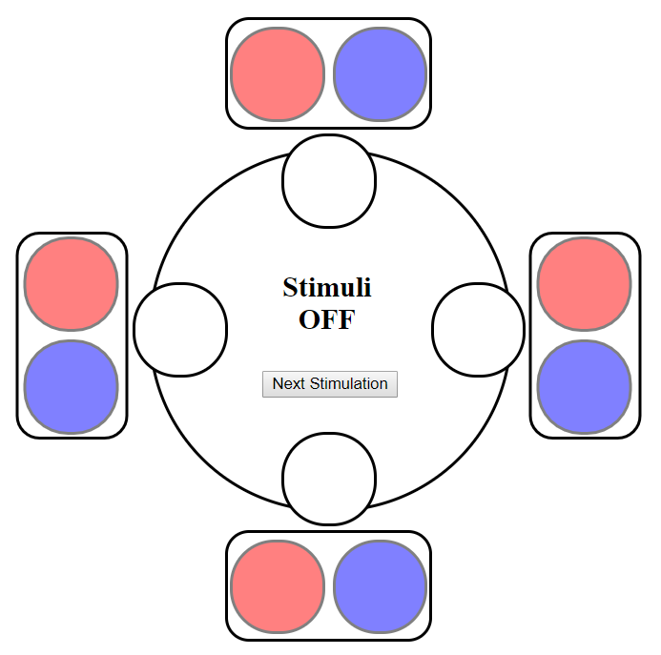

Slide 8
94.3%
89.8%
86.8%
84.2%
91.7%
83.3%
85.8%
91.7%
86.5%
80.6%
91.7%
83.3%

Slide 9
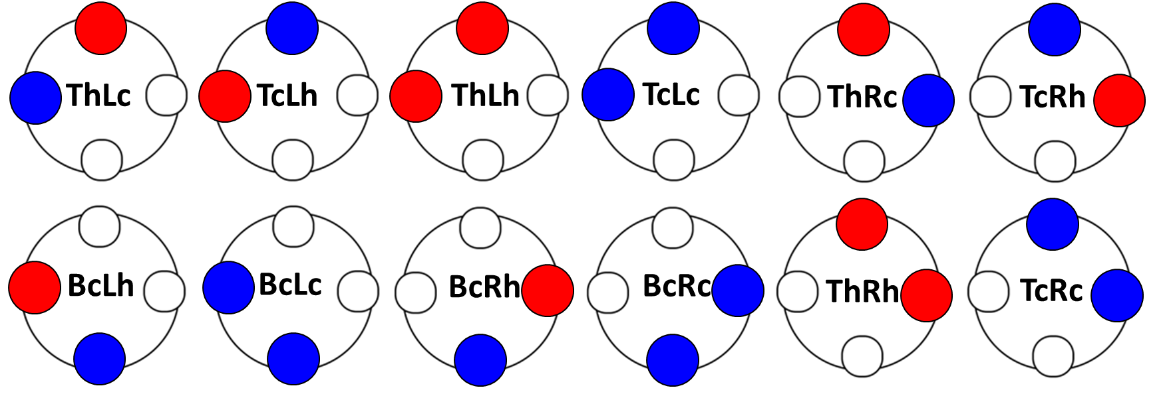
ThLc
TcLh
ThLh
TcLc
ThRc
TcRh
BcLh
BcLc
BcRh
BcRc
ThRh
TcRc

Slide 10
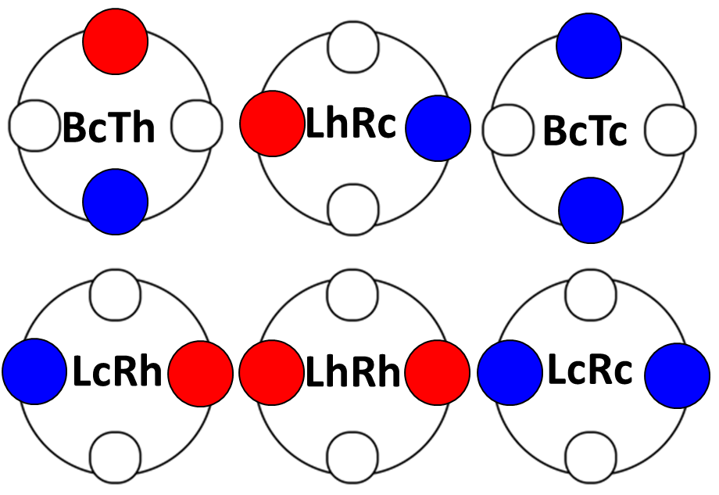
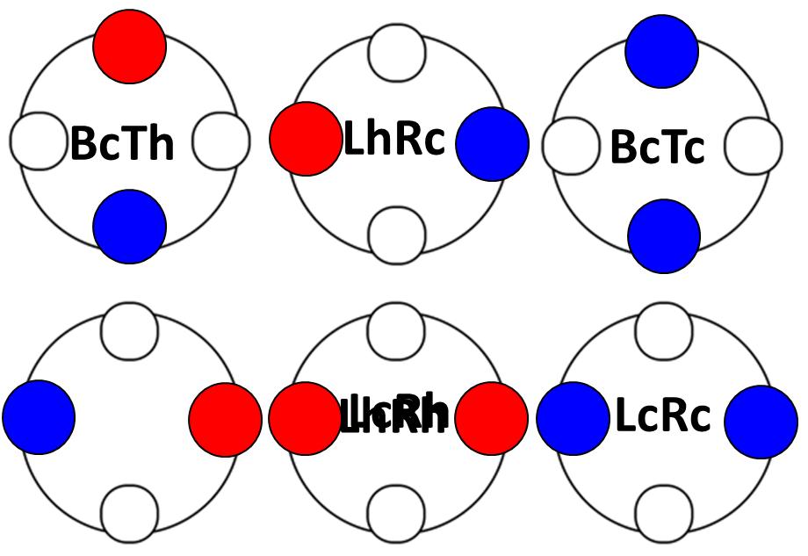
BcTh
LhRc
BcTc
LcRh
LhRh
LcRc

Slide 11
Group 1: Single-spot Cold Stimulations
Group 2: Opposite Patterns
Group 3: Neighboring Patterns
Tc
Rc
LcRc
BcTc
TcRc
TcLc
(1)
(2)
(5)
(6)
(10)
(11)
BcRc
Bc
Lh
BcTh
LhRc
LcRh
(3)
(4)
(7)
(8)
(9)
(12)

